Slide 1
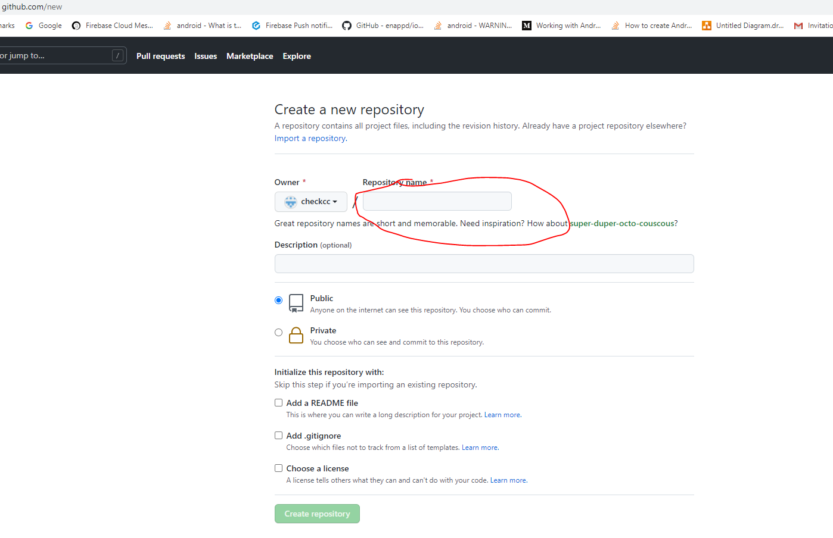
https://github.com/checkcc/myrepostudent2021.git

Slide 2
gh repo clone ankit078622/WebServiecesAssign

Slide 3
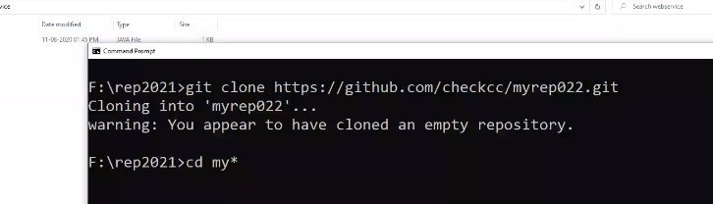
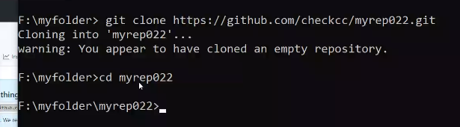
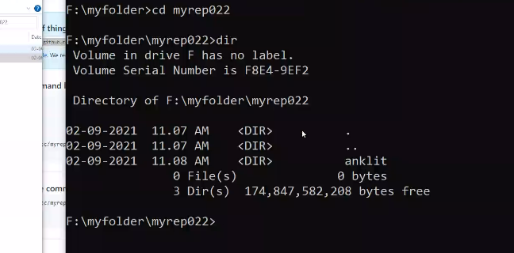

Slide 4
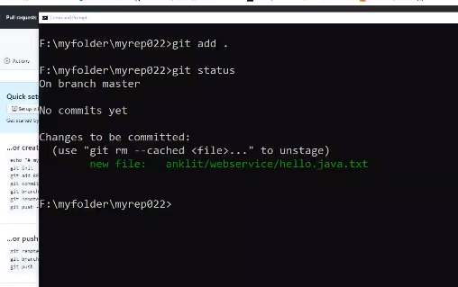
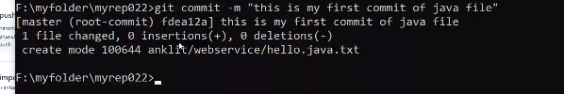

Slide 5
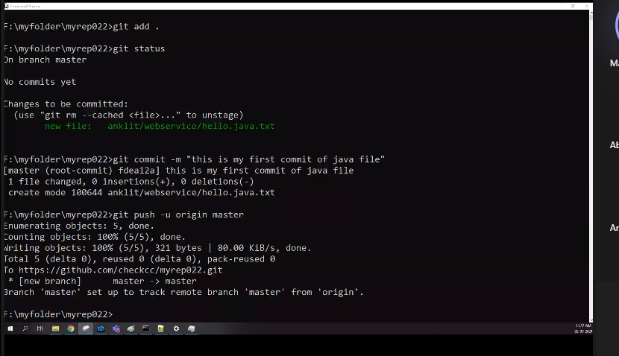
git clone https://github.com/checkcc/myrep022.git git add . git status git commit -m "this is my first commit of java file" git push -u origin master

Slide 6
